Slide 1

Greek Literature in the Era of the
Atheno-Peloponnesian Wars (431–404 BCE)
History of Scholarship: From Dionysius of Halicarnassus to Felix Jacoby
Spring Semester 2026
Prof. Dr. Ruobing Xian

Slide 2

Part I
The Development of Ancient Historiography:
Ancient Model

Slide 3

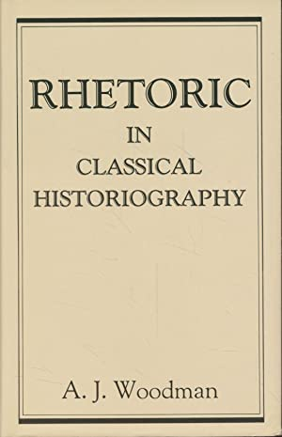

Ancient Historiography: The Classical Foundations of Modern Historiography?

Slide 4
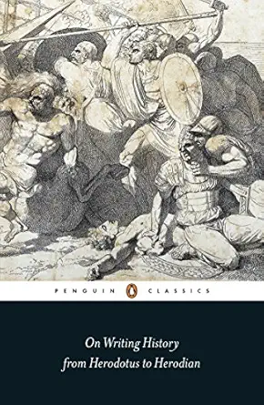
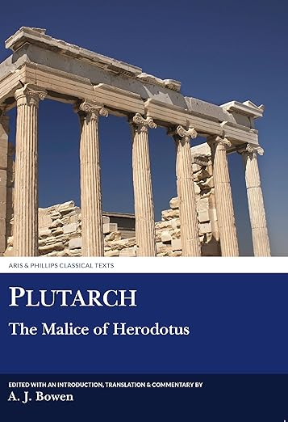

On Writing History

Slide 5
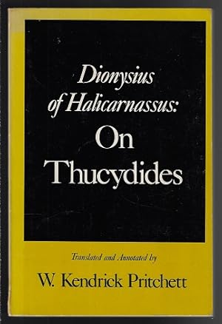
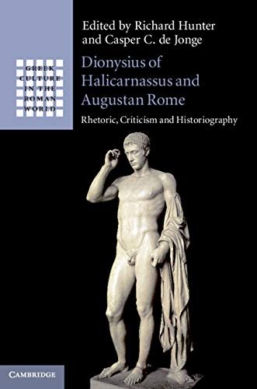
Dionysius of Halicarnassus On Thucydides

Slide 6
Part II
The Development of Ancient Historiography: Modern Model

Slide 7
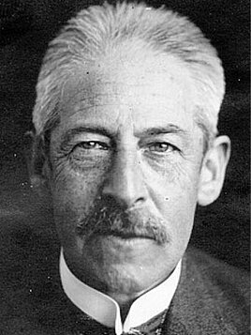
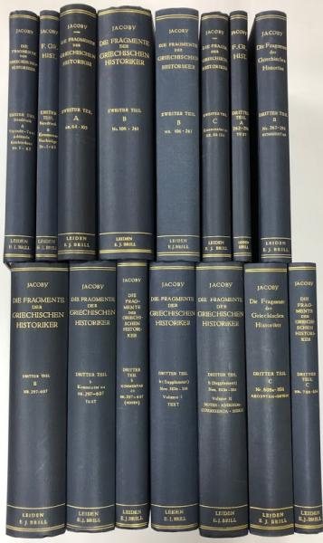
Felix Jacoby and The Fragments of Ancient Greek Historians I-III (1923-1958)

Slide 8
Felix Jacoby and The Fragments of Ancient Greek Historians I-III (1923-1958)

Slide 9
Felix Jacoby and Die Fragmente der griechischen Historiker I-III (1923-1958)

Slide 10
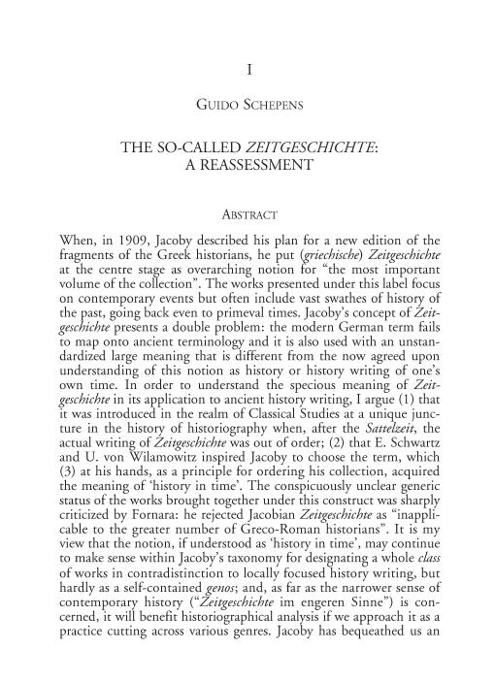

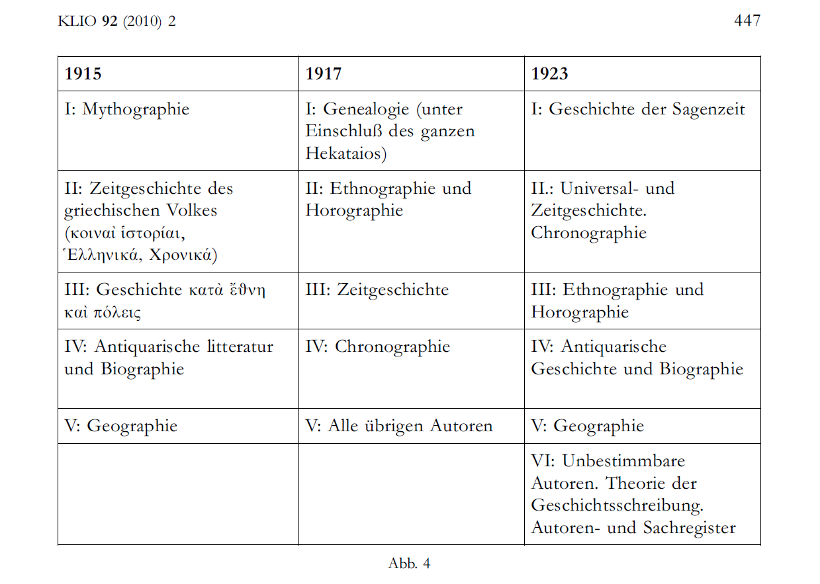
Guido Schepens’ Interpretation

Slide 11
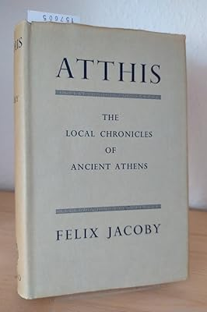
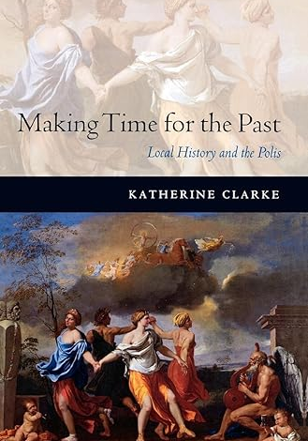

Ancient Greek Local (or Polis) Histories

Slide 12
Thanks for your attention！
Contact: ruobingxian@fudan.edu.cn

